Slide 1
Capstone Project
Bike Sharing By IRSHAD

Slide 2
Bike Sharing Demand
1.Defining problem statement
2.EDA and feature engineering
3.Feature selection
4.Prepration data for good understanding
5.Predict conclusion using Machine Learning algorithm

Slide 3
DATA PIPELINE
DATA PROCESSING-1: In this first part we have removed unnecessary feature since there were nearly many columns with all null values
DATA PROCESSING-2 :In this part we manually go through each features selected from part 1 and encoded the categorical features, changed the columns containing date time value.
EDA: In this part we do some exploratory data analysis on the features selected in part 1 and part 2 to see the trend
CREATE A MODEL: Finally in this last but not the last part we create models
Creating the models is also not an easy task. It’s also an iterative process show how to start with a simple model , then slowly add complexity for better performance
MACHINE LEARNING ALGORITHM: In this data we apply different algorithm to get the best conclusion and also use some hyper parameter tunning to get more efficient result

Slide 4
DATA SUMMARY
The benefits of bike sharing schemes include transport flexibility, reductions to vehicle emissions, health benefits, reduced congestion and fuel consumption, and financial savings for individuals.
This dataset contains the hourly and daily count of rental bikes between years 2011 and 2012 in Capital bike share system with the corresponding weather and seasonal information. The dataset contains 17379 rows (every hour of each day for 2011 and 2012) and 17 columns (the features which are under consideration). We also included the trip data for year 2011 for analysing the station level data.
Natural factors include seasons, months, day of week ,peak timings, working and non-working days, temperature, humidity etc. and man made factors consists of location of bike station, characteristics of the area.

Slide 5
DATA DEPENDENT VARIABLE
Date : The date of the day, during 365 days from 01/12/2017 to 30/11/2018, formating in DD/MM/YYYY, type : str we need to convert into date time format.
Rented Bike Count : Number of rented bikes per hour which our dependent variable and we need to predict that, type : int
Hour: The hour of the day, starting from 0-23 it's in a digital time format, type : int, we need to convert it into category data type.
Temperature(°C): Temperature in Celsius, type : Float
Humidity(%): Humidity in the air in %, type : int
Wind speed (m/s) : Speed of the wind in m/s, type : Float
Visibility (10m): Visibility in m, type : int
Dew point temperature(°C): Temperature at the beggining of the day, type : Float

Slide 6
Solar Radiation (MJ/m2): Sun contribution, type : Float
Rainfall(mm): Amount of raining in mm, type : Float
Snowfall (cm): Amount of snowing in cm, type : Float
Seasons: Season of the year, type : str, there are only 4 season's in data .
Holiday: If the day is holiday period or not, type: str
Functioning Day: If the day is a Functioning Day or not, type : str

Slide 7
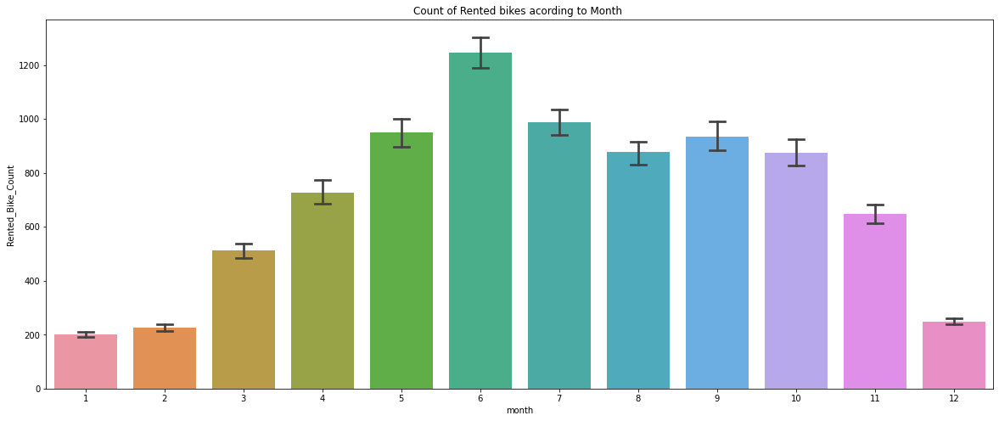
Exploratory Data Analysis

Slide 8
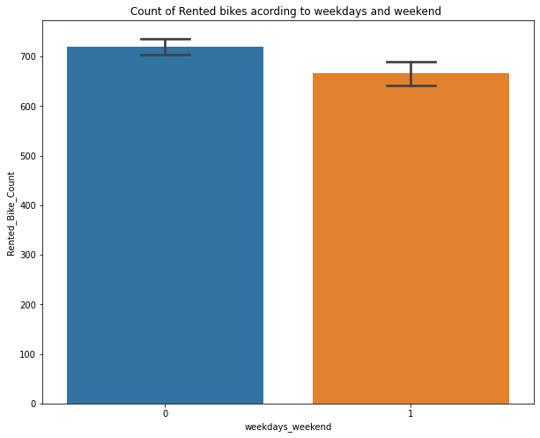
Exploratory Data Analysis(Continued)

Slide 9
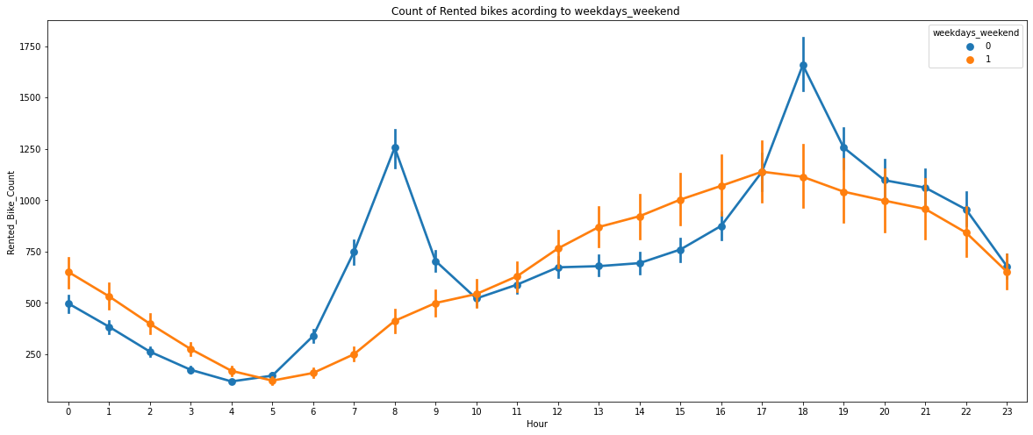
Exploratory Data Analysis(Continued)

Slide 10
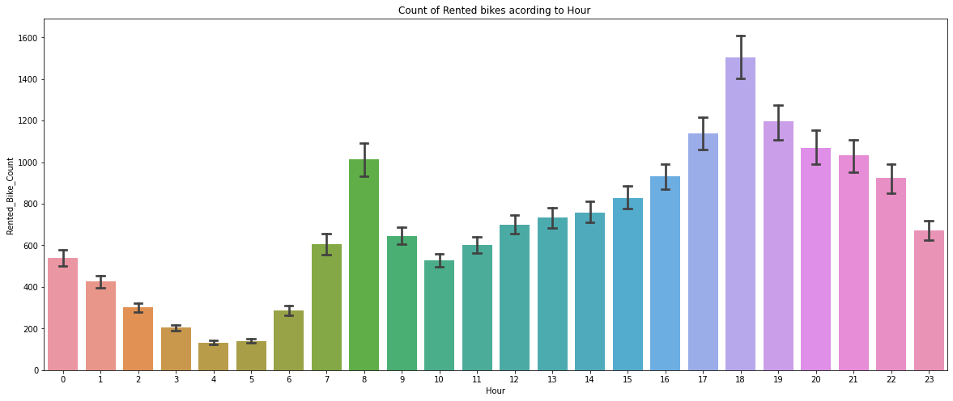
Exploratory Data Analysis(Continued)

Slide 11
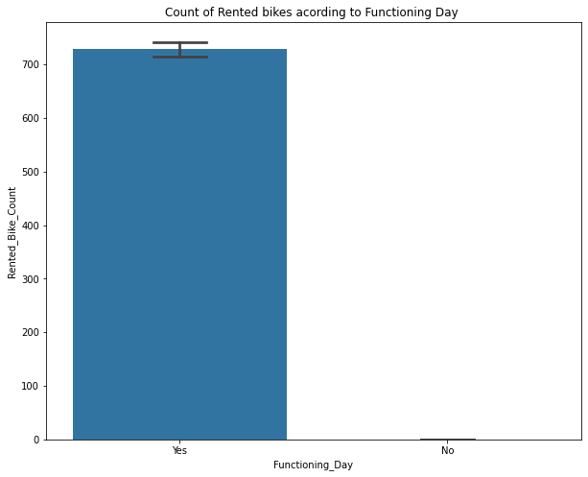
Exploratory Data Analysis(Continued)

Slide 12
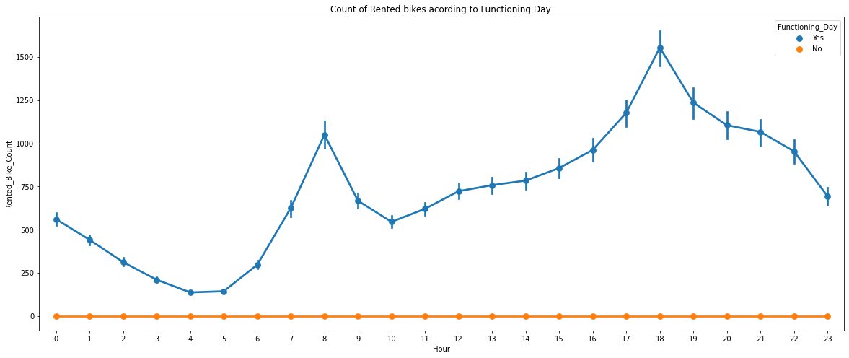
Exploratory Data Analysis(Continued)

Slide 13
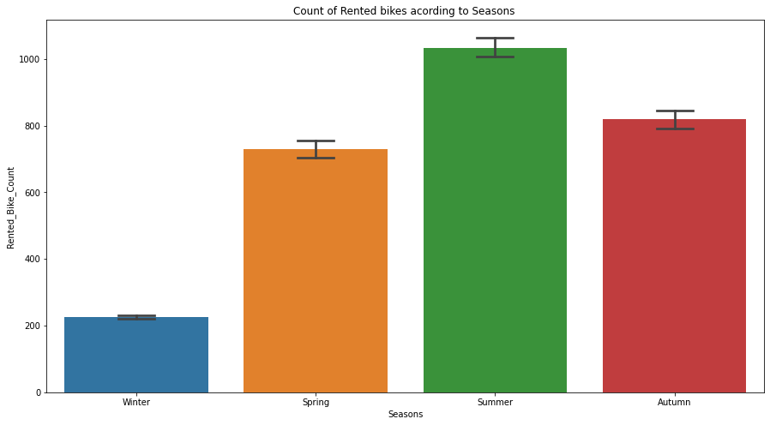
Exploratory Data Analysis(Continued)

Slide 14
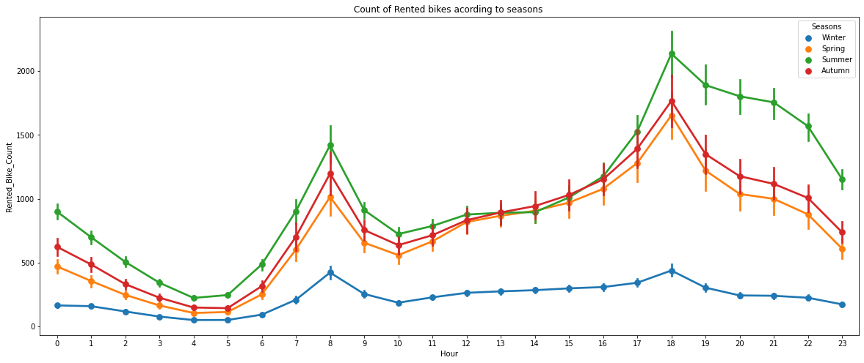
Exploratory Data Analysis(Continued)

Slide 15
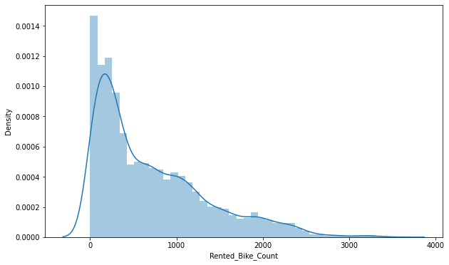
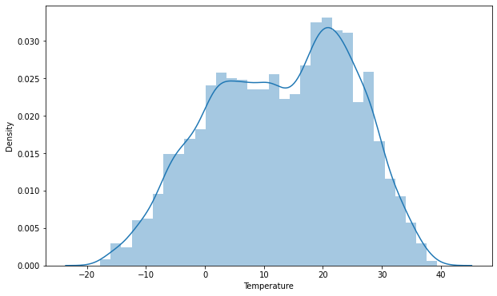
Exploratory Data Analysis(Continued)

Slide 16
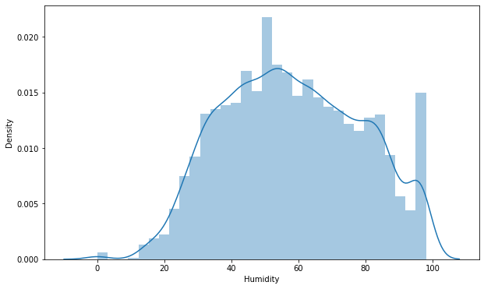
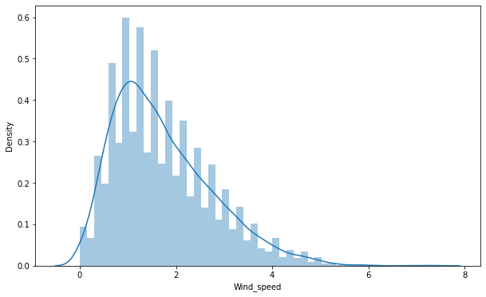
Exploratory Data Analysis(Continued)

Slide 17
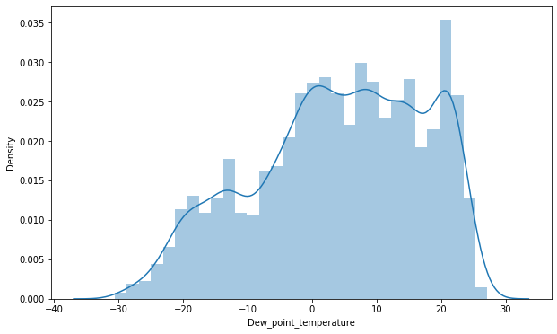
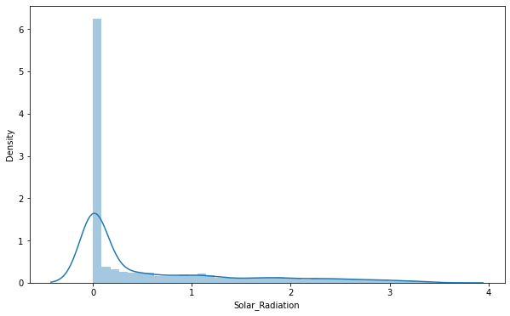
Exploratory Data Analysis(Continued)

Slide 18
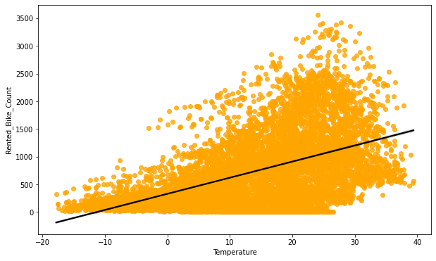
Regression plot

Slide 19
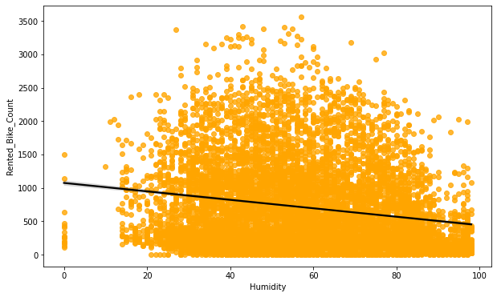
Regression plot

Slide 20
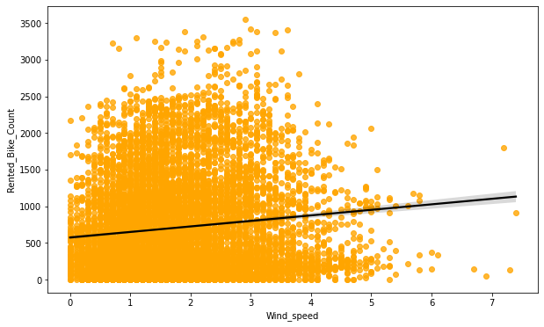
Regression plot

Slide 21
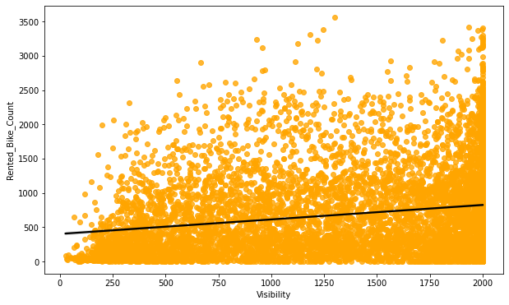
Regression plot

Slide 22
Regression plot

Slide 23
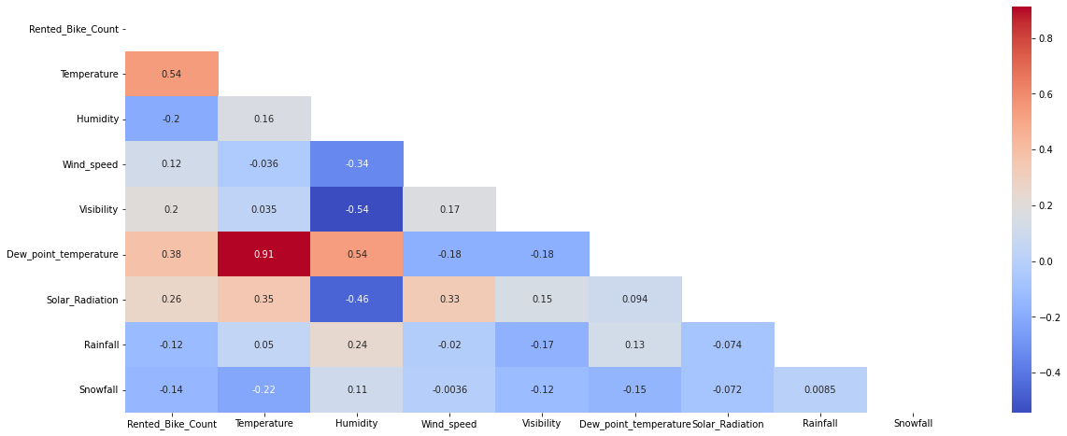
Checking of Correlation between variables

Slide 24
LINEAR REGRESSION
Regression models describe the relationship between variables by fitting a line to the observed data. Linear regression models use a straight line
Linear regression uses a linear approach to model the relationship between independent and dependent variables
MSE : 35.077512
RMSE: 5.922627
MAE: 4.4740240
R2: 0.77221015
ADJUSTED R2: 0.767211964
Looks like our r2 score value is 0.77 that means our model is able to capture most of the data variance. Lets save it in a data frame for later comparisons.

Slide 25
LASSO REGRESSION
MSE : 91.59423336097032
RMSE : 9.570487623991283
MAE : 7.255041571454952
R2 : 0.40519624904934015
Adjusted R2 : 0.3921449996120475
Looks like our r2 score value is 0.40 that means our model is not able to capture most of the data variance. Lets save it in a data frame for later comparisons.

Slide 26
RIDGE REGRESSION
MSE : 35.07752456136463
RMSE : 5.922628180239296
MAE : 4.474125776125378
R2 : 0.7722100789802107
Adjusted R2 : 0.7672118874358922
Looks like our r2 score value is 0.77 that means our model is able to capture most of the data variance. Lets save it in a data frame for later comparisons.

Slide 27
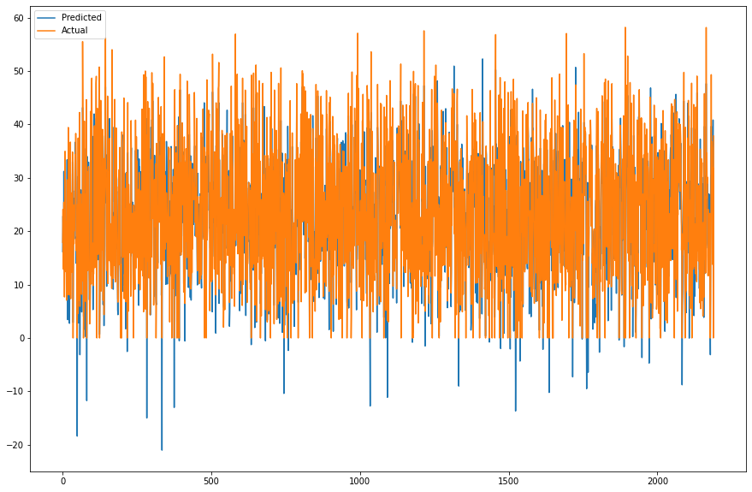
RIDGE REGRESSION

Slide 28
ELASTIC NET REGRESSION
MSE : 57.5742035398887
RMSE : 7.587766703048315
MAE : 5.792276538970546
R2 : 0.6261189054494012
Adjusted R2 : 0.6179151652795234
Looks like our r2 score value is 0.62 that means our model is able to capture most of the data variance. Lets save it in a dataframe for later comparisons.

Slide 29
DECISION TREE
Model Score: 0.6799535533778143
MSE : 49.28416956249743
RMSE : 7.020268482223271
MAE : 5.170334160033761
R2 : 0.6799535533778143
Adjusted R2 : 0.6729310589841435
Looks like our r2 score value is 0.67 that means our model is able to capture most of the data variance. Lets save it in a data frame for later comparisons.

Slide 30
RANDOM FOREST
Model Score: 0.9895620801374047
MSE : 1.6073423648886425
RMSE : 1.2678100665670085
MAE : 0.8064650602500485
R2 : 0.9895620801374047
Adjusted R2 : 0.9893330501497567
Looks like our r2 score value is 0.98 that means our model is able to capture most of the data variance. Lets save it in a data frame for later comparisons

Slide 31
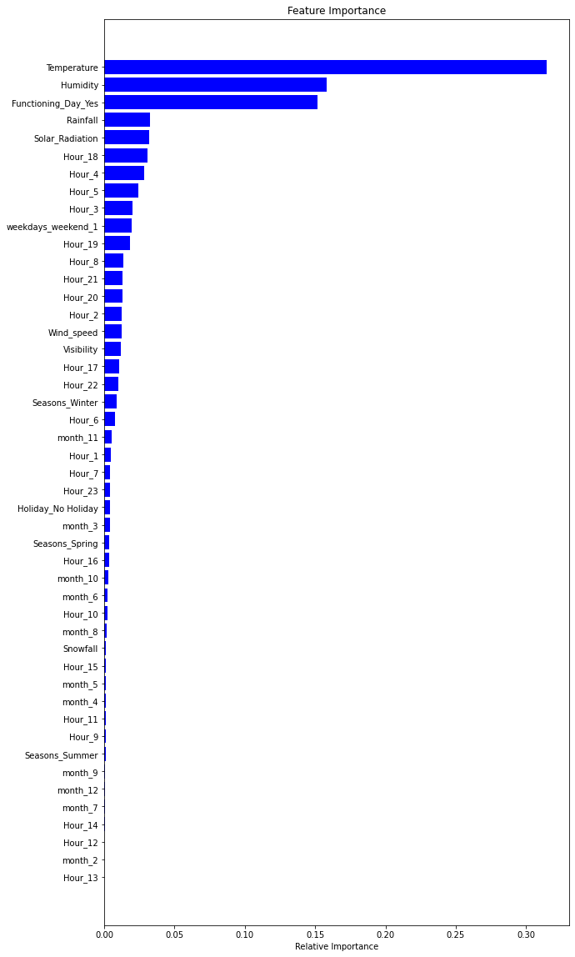

Slide 32
GRADIENT BOOSTING
Model Score: 0.8789016499095264
MSE : 18.64801713184794
RMSE : 4.3183349953249275
MAE : 3.2690035692731247
R2 : 0.8789016499095264
Adjusted R2 : 0.8762444965695393
Looks like our r2 score value is 0.87 that means our model is able to capture most of the data variance. Lets save it in a dataframe for later comparisons.

Slide 33
CONCLUSION
 |  | MODEL | MAE | MSE | RMSE | R2_score | ADJ. R2
Training set | 0 | Linear regression | 4.474 | 35.078 | 5.923 | 0.772 | 0.77
 | 1 | Lasso regression | 7.255 | 91.594 | 9.570 | 0.405 | 0.39
 | 2 | Ridge regression | 4.474 | 35.078 | 5.923 | 0.772 | 0.77
 | 3 | Elastic net regression | 5.792 | 57.574 | 7.588 | 0.626 | 0.62
 | 4 | Dicision tree regression | 5.170 | 49.284 | 7.020 | 0.680 | 0.67
 | 5 | Random forest regression | 0.806 | 1.607 | 1.268 | 0.990 | 0.99
 | 6 | Gradient boosting regression | 3.269 | 18.648 | 4.318 | 0.879 | 0.88
 | 7 | Gradient Boosting gridsearchcv | 1.849 | 7.455 | 2.730 | 0.952 | 0.95

Slide 34
Model | MAE | MSE | RMSE | R2_score | Adjusted R2
0 | Linear regression | 4.410 | 33.275 | 5.768 | 0.789 | 0.78
1 | Lasso regression | 7.456 | 96.775 | 9.837 | 0.387 | 0.37
2 | Ridge regression | 4.410 | 33.277 | 5.769 | 0.789 | 0.78
3 | Elastic net regression Test | 5.874 | 59.451 | 7.710 | 0.624 | 0.62
4 | Dicision tree regression | 5.455 | 55.045 | 7.419 | 0.652 | 0.64
5 | Random forest regression | 2.204 | 12.587 | 3.548 | 0.920 | 0.92
6 | Gradient boosting regression | 3.493 | 21.289 | 4.614 | 0.865 | 0.86
7 | Gradient Boosting gridsearchcv | 2.401 | 12.393 | 3.520 | 0.922 | 0.92
Test set

Slide 35
• No overfitting is seen.
• Random forest Regression and Gradient Boosting grid search cv gives the highest R2 score of 99% and 95% respectively for Train Set and 92% for Test set.
• Feature Importance value for Random Forest and Gradient Boost are different.
• We can deploy this model.
However, this is not the ultimate end. As this data is time dependent, the values for variables like temperature, wind speed, solar radiation etc., will not always be consistent. Therefore, there will be scenarios where the model might not perform well. As Machine learning is an exponentially evolving field, we will have to be prepared for all contingencies and also keep checking our model from time to time. Therefore, having a quality knowledge and keeping pace with the ever evolving ML field would surely help one to stay a step ahead in future.

